Slide 1
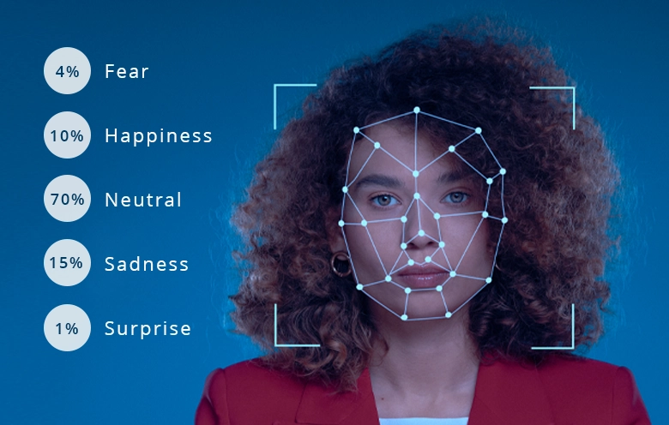
Expression Detection
Sunny Singh

Slide 2
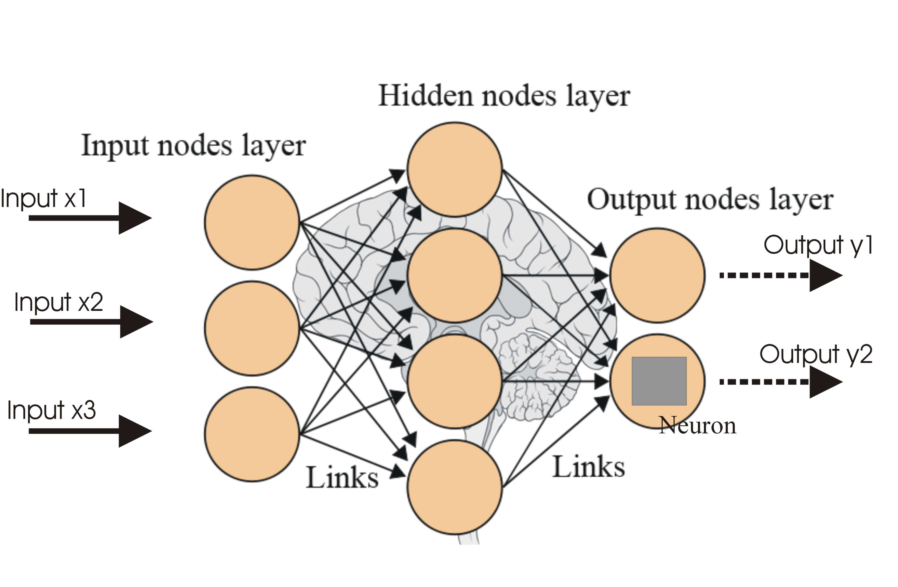
Introduction to Neural Networks
CNNs is convolution neural networks designed for processing data, it is used in image Detection and analysis.
Expression Detection is done in convolution neural network.

Slide 3
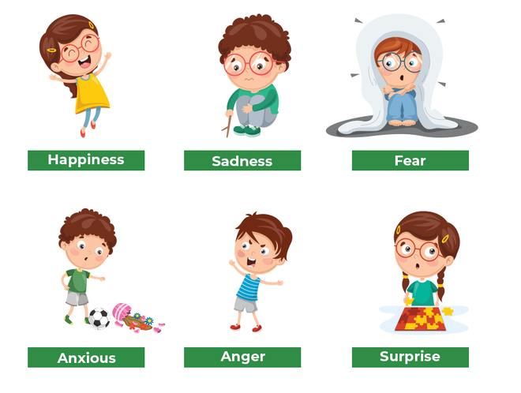
OBJECTIVE
Classify images into predefined categories or classes.
Explain how CNNs learn to differentiate between objects, scenes, or patterns within images.
Examples: Identifying human emotions.

Slide 4
PROCESS FLOW
Data Collection
Data Import
Data Preprocessing
Data Visualization
Select best model
Checking Accuracy
Model Building

Slide 5
TOOLS AND PLATFORM USED
Tools :- Python.
Platform :- Jupyter Notebook.
Library Used :- Pandas and NumPy for data analysis and calculation, import matplotlib.pyplot as plt, Seaborn for data Visualization, keras.models in machine learning.
Machine learning Algorithms:- CNNs(convolution neural networks).
For Deployment:- Visual Studio code, HTML and CSS.

Slide 6
CHALLENGES
Face Challenge while collecting image for various face Expression.
Creating the function for multi face Expression.

Slide 7
Architecture of CNNs
1
Input Layer
Receives the raw input, typically an image or a feature map from a previous layer.
2
Convolutional Layers
Extracts features through convolution operations, applying filters to the input data.
3
Fully Connected Layers
Neurons in this layer connect to all activations in the previous layer, providing high-level reasoning.

Slide 8
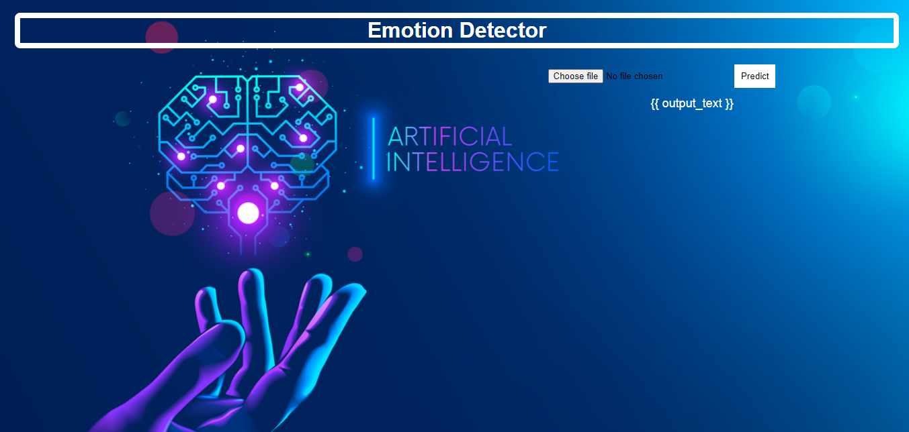
Deployment

Slide 9
Conclusion
The model is successfully classifying the image hence we can say that in which Expression the peoples are.
CNNs models find application in various Real-life scenarios ,especially in fields where understanding and processing is crucial.
Commomly used, Computer vision ,Healthcare ,Gaming and Image Segmentation.

Slide 10
THANK you

